Slide 1

ISACA®
TRUST IN, AND VALUE FROM, INFORMATION SYSTEMS

Slide 2
CISA® Review Course
CHAPTER 1
THE PROCESS OF AUDITING INFORMATION SYSTEMS
Notes:
Pgs. 24

Slide 3
Course Agenda
Learning Objectives
Discuss Task and Knowledge Statements
Discuss specific topics within the chapter
Notes:
Instructor Directions:
Advise participants that the course will be interactive and will include “audience participation”, breakout sessions, practice questions, assignments and references to additional study resources.
Exam Preparation resources:
CISA Review Manual 2012
CISA QAE 2011
CISA QAE Supplement 2012
Pgs. 24 - 32

Slide 4
Exam Relevance
Ensure that the CISA candidate…
Has the knowledge necessary to provide audit services in accordance with IT audit
standards to assist the organization with protecting and controlling information
Systems.
Candidates can write their exam at PSI exam Center s
The content area in this chapter
will represent approximately 21% of
the CISA examination
(approximately 31 questions).
Notes:
Instructor Directions:
This chapter (module) represents 14% of the CISA examination.

Slide 5
Chapter 1 Learning Objectives
Develop and implement a risk-based IT audit strategy in compliance with IT audit standards to ensure that key areas are included
Plan specific audits to determine whether information systems are protected, controlled and provide value to the organization
Conduct audits in accordance with IT audit standards to achieve planned audit objectives
Notes:
Content to Emphasize:
The CISA candidate must have a thorough understanding of the knowledge statements in order to pass the CISA exam.
For a detailed explanation of each knowledge statement along with key concepts that map back to the task statements, please refer to KS 1.1 through KS 1.10.
Review Manual Reference Pages:
pgs. 24-30

Slide 6
Learning Objectives
(continued)
Report audit findings and make recommendations to key stakeholders to communicate results and effect change when necessary
Conduct follow-ups or prepare status reports to ensure appropriate actions have been taken by management in a timely manner
Notes:
Content to Emphasize:
The CISA candidate must have a thorough understanding of the knowledge statements in order to pass the CISA exam.
For a detailed explanation of each knowledge statement along with key concepts that map back to the task statements, please refer to KS 1.1 through KS 1.10.
Review Manual Reference Pages:
pgs. 24-32

Slide 7
1.2.1 Organization of the IS Audit Function
IS audit is the formal examination, interview and/or testing of information systems to determine whether:
Information systems are in compliance with applicable laws, regulations, contracts and/or industry guidelines
IS data and information have appropriate levels of confidentiality, integrity and availability
IS operations are being accomplished efficiently and effectiveness targets are being met
Notes:
Content to Emphasize:
The highest level of management and the audit committee, if available, should approve this charter.
An audit charter is an overarching document that covers the entire canvas of audit activities in an entity while an engagement letter is more focused on a particular audit exercise that is sought to be initiated in an organization with a specific objective in mind.
Review Manual Reference Pages:
pg. 33

Slide 8
1.2.1 Organization of the IS Audit Function
Audit charter (or engagement letter)
Outline the overall authority, scope and responsibilities of the audit function
Audit charter should clearly state management's responsibility and objectives for, and delegation of authority
Audit committee or Senior Management approves the audit charter.
Internal audit function should be independent and report to an audit committee or board of directors
Engagement letter
Change in the audit charter
Notes:
Content to Emphasize:
The highest level of management and the audit committee, if available, should approve this charter.
An audit charter is an overarching document that covers the entire canvas of audit activities in an entity while an engagement letter is more focused on a particular audit exercise that is sought to be initiated in an organization with a specific objective in mind.
Review Manual Reference Pages:
pg. 33

Slide 9
1.2.2 IS Audit Resource Management
Skills and knowledge should be taken into consideration when planning audits and assigning staff to specific audit assignments.
IS audit management should also provide the necessary IT resources to properly perform IS audits of a highly specialized nature
ISACA IS Audit and Assurance Standards require that the IS auditor be technically competent , having the skills and knowledge necessary to perform the auditor's work
Notes:
Content to Emphasize:
important that IS auditors maintain their competency through updates of existing skills and obtain training directed toward new audit techniques and technological areas.
Review Manual Reference Pages:
pg. 33

Slide 10
1.2.3 Audit Planning
Short-term planning takes into account audit issues that will
be covered during the year.
Long term planning relates to audit plans that will takes into account risk related issues regarding changes in IT strategic direction that will affect the organization IT environment.
Notes:
Content to Emphasize:
Analysis of short- and long-term issues should occur at least annually.
Review Manual Reference Pages:
pgs. 33 - 34

Slide 11
1.2.3 Audit Planning (continued)
Audit planning steps:
Gain an understanding of the business’s mission, objectives, purpose and processes which include information and processing requirements such as availability, integrity, security and business technology and information confidentiality
Understand changes in Business environment of auditee
Review prior work papers.
Identify stated contents such as policies, standards, guidelines, procedures, and organization structure
Notes:
Content to Emphasize:
When planning an audit, the IS auditor must have an understanding of the overall environment under review. For example, the IS auditor should be familiar with the regulatory environment in which the business operates.
Review Manual Reference Pages:
pgs. 33 - 34

Slide 12
1.2.3 Audit Planning (continued)
Audit planning steps (continued)
Perform a risk analysis to help in designing the audit plan
Set the audit scope and audit objectives
Develop the audit approach or audit strategy
Assign personnel resources to audit
Address engagement logistics
Notes:
Review Manual Reference Pages:
pgs. 33 - 34

Slide 13
1.2.3 Audit Planning (continued)
Steps to gain an understanding of the business include:
Reading background material including industry publications, annual report is and independent financial analysis reports
Reviewing prior audit reports or IT-related reports (from external or internal audits, or specific reviews such as regulatory reviews)
Reviewing business and IT long-term strategic plans
Interviewing key managers to understand business issues
Identifying specific regulations applicable to IT
Identifying IT functions or related activities that have been outsourced
Touring key organization facilities
Notes:
Review Manual Reference Pages:
pgs. 33 - 34

Slide 14
1.2.4 Effect of Laws and Regulations on IS Audit Planning
The Content of legal regulation pertain to :
Establishment of Regularity requirement
  Responsibilities assigned to corresponding entities
  Financial, operational and IT audit functions
Notes:
Content to Emphasize:
Special attention should be given to these issues in those industries that, historically, have been closely regulated. Ex – banking industry
IS auditors should review management’s privacy policy to ascertain whether it takes into account the requirements of applicable privacy laws and regulations, including transborder data flow requirements such as Safe Harbor and the Organization for Economic Cooperation and Development (OECD) guidelines governing the protection of privacy and transborder flows of personal data.
Review Manual Reference Pages:
Pgs. 34 - 35

Slide 15
1.2.4 Effect of Laws and Regulations on IS Audit Planning
The Content of legal regulation pertain to :
Health Insurance Portability and Accountability Act (HIPAA)
General Data Protection Regulation (GDPR)
Notes:
Content to Emphasize:
Special attention should be given to these issues in those industries that, historically, have been closely regulated. Ex – banking industry
IS auditors should review management’s privacy policy to ascertain whether it takes into account the requirements of applicable privacy laws and regulations, including transborder data flow requirements such as Safe Harbor and the Organization for Economic Cooperation and Development (OECD) guidelines governing the protection of privacy and transborder flows of personal data.
Review Manual Reference Pages:
Pgs. 34 - 35

Slide 16
1.2.4 Effect of Laws and Regulations on IS Audit Planning (continued)
Steps Auditor would follow to determine compliance with external requirements:
Identify external requirements
Document applicable laws and regulations
Assess whether management and the IS function have considered the relevant external requirements
Review internal IS department documents that address adherence to applicable laws
Determine adherence to established procedures that address these requirements
Notes:
Instructor Directions:
A CISA candidate will not be asked about any specific laws or regulations, but may be questioned about how one would audit for compliance with laws and regulations. Address with the candidates the importance of setting legal advice.
Review Manual Reference Pages:
pg. 35

Slide 17
1.3.1 ISACA Code of Professional Ethics
Members and ISACA certification holders shall:
Support the implementation of, and encourage compliance with, appropriate standards, procedures for the effective governance and management of enterprise information systems and technology, including: audit, control, security and risk management.
Perform their duties with objectivity, due diligence and professional care, in accordance with professional standards.
Serve in the interest of stakeholders in a lawful manner, while maintaining high standards of conduct and character, and not discrediting their profession or the Association.
Notes:
Instructor Directions:
Instructors need to know the specifics of the code of ethics and be able to explain the importance of each component to the candidates.
Content to Emphasize:
Members and ISACA certification holders shall:
1. Support the implementation of, and encourage compliance with, appropriate standards, procedures and controls for information systems.
2. Perform their duties with objectivity, due diligence and professional care, in accordance with professional standards and best practices.
3. Serve in the interest of stakeholders in a lawful and honest manner, while maintaining high standards of conduct and character, and not engage in acts discreditable to the profession.
4. Maintain the privacy and confidentiality of information obtained in the course of their duties unless disclosure is required by legal authority. Such information shall not be used for personal benefit or released to inappropriate parties.
5. Maintain competency in their respective fields and agree to undertake only those activities that they can reasonably expect to complete with professional competence.
6. Inform appropriate parties of the results of work performed, revealing all significant facts known to them.
7. Support the professional education of stakeholders in enhancing their understanding of IS security and control. Failure to comply with this Code of Professional Ethics can result in an investigation into a member’s and/or certification holder’s conduct and, ultimately, in disciplinary measures.
Review Manual Reference Pages:
pg. 35

Slide 18
1.3.1 ISACA Code of Professional Ethics
Members and ISACA certification holders shall:
Maintain the privacy and confidentiality of information obtained in the course of their activities.
Maintain competency in their respective fields and agree to undertake only those activities they can reasonably expect to complete with the necessary skills, knowledge and competence.
Inform appropriate parties of the results of work performed, including the disclosure of all significant facts known to them that, if not disclosed, may distort the reporting of the results.
Support the professional education of stakeholders in enhancing their understanding of the governance and management of enterprise information systems and technology, including: audit, control, security and risk management.
Notes:
Instructor Directions:
Instructors need to know the specifics of the code of ethics and be able to explain the importance of each component to the candidates.
Content to Emphasize:
Members and ISACA certification holders shall:
1. Support the implementation of, and encourage compliance with, appropriate standards, procedures and controls for information systems.
2. Perform their duties with objectivity, due diligence and professional care, in accordance with professional standards and best practices.
3. Serve in the interest of stakeholders in a lawful and honest manner, while maintaining high standards of conduct and character, and not engage in acts discreditable to the profession.
4. Maintain the privacy and confidentiality of information obtained in the course of their duties unless disclosure is required by legal authority. Such information shall not be used for personal benefit or released to inappropriate parties.
5. Maintain competency in their respective fields and agree to undertake only those activities that they can reasonably expect to complete with professional competence.
6. Inform appropriate parties of the results of work performed, revealing all significant facts known to them.
7. Support the professional education of stakeholders in enhancing their understanding of IS security and control. Failure to comply with this Code of Professional Ethics can result in an investigation into a member’s and/or certification holder’s conduct and, ultimately, in disciplinary measures.
Review Manual Reference Pages:
pg. 35

Slide 19
1.3.2 ISACA IT Audit and Assurance Standards Framework
Framework for the ISACA IS Audit & Assurance Standards:
Standards
Guidelines
Tool & Techniques
Notes:
Instructor Directions:
Please see Appendix B on IS Auditing Standards, Guidelines and Procedures. The complete text of these guidelines and procedures is available at www.isaca.org/standards.
Content to Emphasize:
The specialized nature of IS auditing and the skills and knowledge necessary to perform such audits require globally applicable standards that pertain specifically to IS auditing. One of the most important functions of ISACA is providing information (common body of knowledge) to support knowledge requirements. (See standard S4 Professional Competence.)
One of ISACA’s goals is to advance standards to meet this need. The development and dissemination of the IS Auditing Standards is a cornerstone of the association’s professional contribution to the audit community. The IS auditor needs to be aware that there may be additional standards, or even legal requirements through legislation, placed on the auditor.
Review Manual Reference Pages:
p. 36 - 38

Slide 20
1.3.2 ISACA IT Audit and Assurance Standards Framework (continued)
The Framework of ISACA IS audit and assurance standard provides multiple of documents :
Standard define mandatory requirement for IS Audit, and assurance reporting .
Guideline provides guidance in applying IS audit and assurance standard.
Tool and techniques which can help auditors during audits.
Notes:
Instructor Directions:
Make the students aware of the importance of compliance with standards. The IT auditor, who is a member of ISACA or a CISA, obviously needs to understand and comply with the ISACA auditing standards. He or she needs to be aware that there may be additional standards, or even legal requirements through legislation, placed on the auditor.
Review Manual Reference Pages:
p. 36 - 38

Slide 21
1.3.2 ISACA IT Audit and Assurance Standards Framework (continued)
There are three categories of standards and guidelines:
General- The guiding principles under which the IS assurance profession operates
Performance - Deal with the conduct of the assignment, such as planning and supervision, scoping, risk and materiality, resource mobilization, supervision and assignment management, audit and assurance evidence, and the exercising of professional judgement and due care
Reporting: Address the types of reports, means of communication and the information communicated
Notes:
Instructor Directions:
Make the students aware of the importance of compliance with standards. The IT auditor, who is a member of ISACA or a CISA, obviously needs to understand and comply with the ISACA auditing standards. He or she needs to be aware that there may be additional standards, or even legal requirements through legislation, placed on the auditor.
Review Manual Reference Pages:
p. 36 - 38

Slide 22
1.3.2 ISACA IT Audit and Assurance Standards Framework (continued)
There are three categories of standards and guidelines:
General :
Audit Charter
Organisational Independence
Professional Independence
Reasonable Expectation
Due Professional Care
Skill & Proficiency
Assertions
Criteria
Notes:
Instructor Directions:
Make the students aware of the importance of compliance with standards. The IT auditor, who is a member of ISACA or a CISA, obviously needs to understand and comply with the ISACA auditing standards. He or she needs to be aware that there may be additional standards, or even legal requirements through legislation, placed on the auditor.
Review Manual Reference Pages:
p. 36 - 38

Slide 23
1.3.2 ISACA IT Audit and Assurance Standards Framework (continued)
There are three categories of standards and guidelines:
Performance :
Engagement Planning
Risk Assessment in Planning
Performance and Supervision
Materiality
Evidence
Using the Work of Other Experts
Irregularity and Illegal Acts
Notes:
Instructor Directions:
Make the students aware of the importance of compliance with standards. The IT auditor, who is a member of ISACA or a CISA, obviously needs to understand and comply with the ISACA auditing standards. He or she needs to be aware that there may be additional standards, or even legal requirements through legislation, placed on the auditor.
Review Manual Reference Pages:
p. 36 - 38

Slide 24
1.3.2 ISACA IT Audit and Assurance Standards Framework (continued)
There are three categories of standards and guidelines:
Reporting :
Reporting
Follow-up Activities
Notes:
Instructor Directions:
Make the students aware of the importance of compliance with standards. The IT auditor, who is a member of ISACA or a CISA, obviously needs to understand and comply with the ISACA auditing standards. He or she needs to be aware that there may be additional standards, or even legal requirements through legislation, placed on the auditor.
Review Manual Reference Pages:
p. 36 - 38

Slide 25
1.3.3 ISACA IT Audit and Assurance Guidelines
IS Audit and Assurance Guidelines
General :
Audit Charter
Organisational Independence
Professional Independence
Reasonable Expectation
Due Professional Care
Skill & Proficiency
Assertions
Criteria
Notes:
Content to Emphasize:
The objective of the ISACA IS Auditing Guidelines is to provide further information on how to comply with the ISACA IS Auditing Standards. The IS auditor should:
• Consider them in determining how to implement the above standards
• Use professional judgment in applying them
• Be able to justify any departure
Review Manual Reference Pages:
p. 38 & 39

Slide 26
1.3.3 ISACA IT Audit and Assurance Guidelines
IS Audit and Assurance Guidelines
Performance :
Engagement Planning
Risk Assessment in Planning
Performance and Supervision
Materiality
Evidence
Using the Work of Other Experts
Irregularity and Illegal Acts
Sampling
Notes:
Content to Emphasize:
The objective of the ISACA IS Auditing Guidelines is to provide further information on how to comply with the ISACA IS Auditing Standards. The IS auditor should:
• Consider them in determining how to implement the above standards
• Use professional judgment in applying them
• Be able to justify any departure
Review Manual Reference Pages:
p. 38 & 39

Slide 27
1.3.3 ISACA IT Audit and Assurance Guidelines
IS Audit and Assurance Guidelines
Reporting :
Reporting
Follow-up Activities
Notes:
Content to Emphasize:
The objective of the ISACA IS Auditing Guidelines is to provide further information on how to comply with the ISACA IS Auditing Standards. The IS auditor should:
• Consider them in determining how to implement the above standards
• Use professional judgment in applying them
• Be able to justify any departure
Review Manual Reference Pages:
p. 38 & 39

Slide 28
1.3.4 ISACA IT Audit and Assurance Tools and Techniques
Procedures developed by the ISACA provide examples of possible processes an IS auditor might follow in an audit engagement.
In determining the appropriateness of any specific tool and technique IS auditor should apply their own professional judgment to the specific circumstances
The tools and techniques documents provide information on how to meet the standards when performing IS auditing work
Notes:
Content to Emphasize:
It is not mandatory for the IS auditor to follow these procedures; however, following these procedures will provide assurance that the standards are being followed by the auditor.
Review Manual Reference Pages:
p. 42

Slide 29
1.3.6 Information Technology
Assurance Framework (ITAF™)
ITAF is a comprehensive and good-practice-setting model that:
Provides guidance and tool & technique on the planning, design, conduct and reporting of IS audit and assurance assignments
Defines terms and concepts specific to IS assurance
Establishes standards that address IS audit and assurance professional roles and responsibilities; knowledge and skills; and diligence, conduct and reporting requirements
ITIF provides a single source through which IS audit and assurance professionals can seek guidance, research policies and procedures, obtain audit and assurance programs, and develop effective reports.
Notes:
Review Manual Reference Pages:
pgs. 42-46

Slide 30
1.4 IS CONTROLS
IS Controls- Used to realize the benefits & risk associated with information systems
Internal Controls :
Policies,
Procedures,
Practices
Organizational structures
Notes:
Instructor Directions:
Review Manual Reference Pages:
pg. 46 - 48

Slide 31
1.4 Risk Analysis
Risk analysis is part of audit planning, and help identify risk and vulnerabilities so the IS auditor can determine the controls needed to mitigate those risk
Risk is a combination of probability of an event and its consequences
Risk= Impact * Probability
Risk Management Framework:
ISO 27005
ISO 31000
ISACA's Risk IT Framework
NIST 800-30 - Risk Assessments
Notes:
Instructor Directions:
Review Manual Reference Pages:
pg. 46 - 48

Slide 32
1.4 Risk Analysis
  Risk Analysis serves more then one purpose :
  It helps the IS auditor in his/her evaluation of controls in audit planning.
  It assists the IS auditor in determining audit objectives.
  It supports risk-based audit decision making.
  It helps identify risks and threat to an IT environment
  It helps auditor to determine the controls needed to mitigate those risks
Notes:
Instructor Directions:
Review Manual Reference Pages:
pg. 46 - 48

Slide 33
1.4 Risk Analysis
IS auditors must be able to:
Identify and differentiate risk types and the controls used to mitigate these risks
Have knowledge of common business risks, related technology risks and relevant controls
Evaluate the risk assessment and management techniques used by business managers, and to make assessments of risk to help focus and plan audit work
Understand the risk exists within the audit process
Notes:
Instructor Directions:
In evaluating IT-related business processes applied by an organization, understanding the relationship between risk and control is important for IS audit and control professionals.
Review Manual Reference Pages:
pg. 46 - 48

Slide 34
1.4 Risk Analysis
Analyzing business risks arising from the use of IT, IS auditor to have a clear understanding of:
The purpose and nature of business, the environment in which the business operates and related business risks
The dependence on technology and related dependencies that process and deliver business information
The business risks of using IT and related dependencies and how they impact the achievement of the business goals and objectives
A good overview of the business processes and the impact of IT and related risks on the business process objectives
Notes:
Instructor Directions:
Review Manual Reference Pages:
pg. 46-48

Slide 35
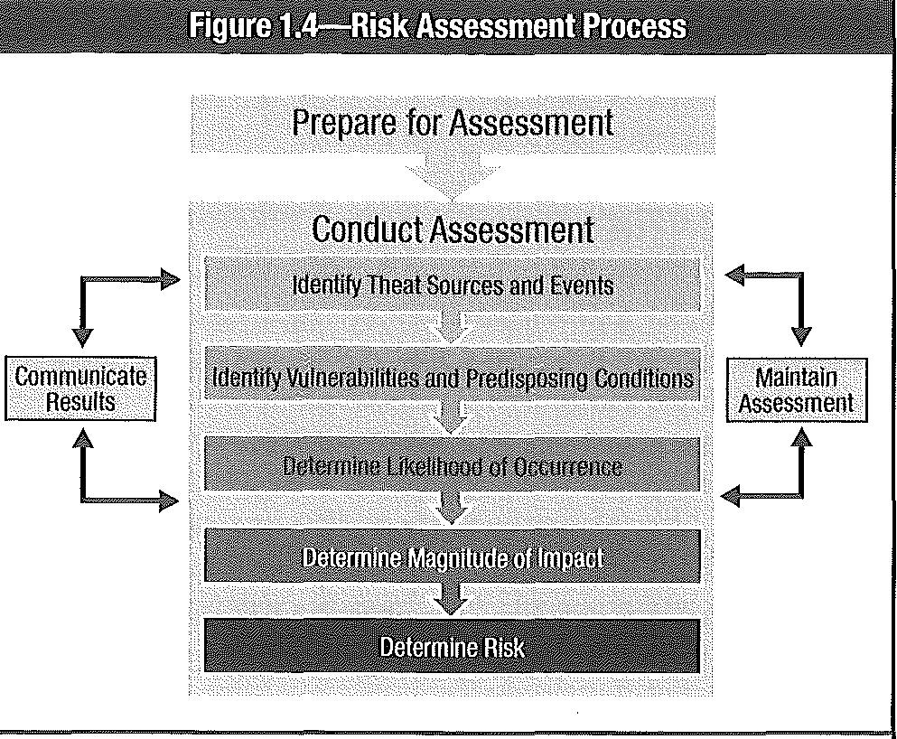
1.4 Risk Analysis (continued)
Notes:
Instructor Directions:
Describe each of the steps in the risk assessment process. Ask participants for input and examples of the risk assessment process in their organization.
Content to Emphasize:
The risk assessment process is characterized as an iterative life cycle which begins with identifying business objectives, information assets, and the underlying systems or information resources that generate/store, use or manipulate the assets (hardware, software, databases, networks, facilities, people, etc.) critical to achieving these objectives.
Next, during the risk mitigation phase, controls are identified for mitigating identified risks. These controls are risk-mitigating countermeasures that should prevent or reduce the likelihood of a risk event occurring, detect the occurrence of a risk event, minimize the impact, or transfer the risk to another organization.
The assessment of countermeasures should be performed through a cost-benefit analysis where controls to mitigate risks are selected to reduce risks to a level acceptable to management. This analysis process may be based on any of the following:
• The cost of the control compared to the benefit of minimizing the risk
• Management’s appetite for risk (i.e., the level of residual risk that management is prepared to accept)
• Preferred risk-reduction methods (e.g., terminate the risk, minimize probability of occurrence, minimize impact, transfer the risk via insurance)
The final phase relates to monitoring performance levels of the risks being managed when identifying any significant changes in the environment that would trigger a risk reassessment, warranting changes to its control environment. It encompasses three processes—risk assessment, risk mitigation and risk reevaluation—in determining whether risks are being mitigated to a level acceptable to management.
Review Manual Reference Pages:
pgs. 47-48

Slide 36
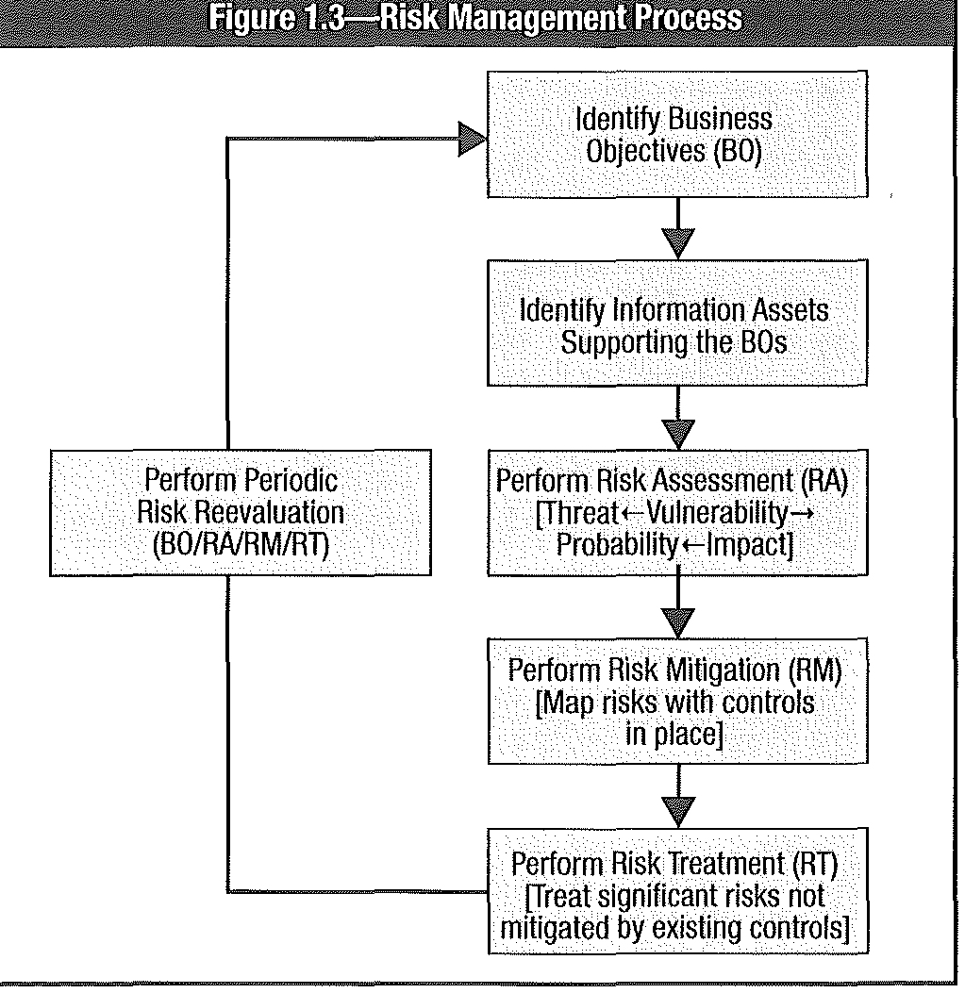
1.4 Risk Analysis (continued)
Notes:
Instructor Directions:
Describe each of the steps in the risk assessment process. Ask participants for input and examples of the risk assessment process in their organization.
Content to Emphasize:
The risk assessment process is characterized as an iterative life cycle which begins with identifying business objectives, information assets, and the underlying systems or information resources that generate/store, use or manipulate the assets (hardware, software, databases, networks, facilities, people, etc.) critical to achieving these objectives.
Next, during the risk mitigation phase, controls are identified for mitigating identified risks. These controls are risk-mitigating countermeasures that should prevent or reduce the likelihood of a risk event occurring, detect the occurrence of a risk event, minimize the impact, or transfer the risk to another organization.
The assessment of countermeasures should be performed through a cost-benefit analysis where controls to mitigate risks are selected to reduce risks to a level acceptable to management. This analysis process may be based on any of the following:
• The cost of the control compared to the benefit of minimizing the risk
• Management’s appetite for risk (i.e., the level of residual risk that management is prepared to accept)
• Preferred risk-reduction methods (e.g., terminate the risk, minimize probability of occurrence, minimize impact, transfer the risk via insurance)
The final phase relates to monitoring performance levels of the risks being managed when identifying any significant changes in the environment that would trigger a risk reassessment, warranting changes to its control environment. It encompasses three processes—risk assessment, risk mitigation and risk reevaluation—in determining whether risks are being mitigated to a level acceptable to management.
Review Manual Reference Pages:
pgs. 47-48

Slide 37
1.5 Internal Controls
Internal controls are normally composed of policies, procedures, practices and organizational structures which are implemented to reduce risks to the organizations
Internal controls are developed to provide reasonable assurance to management that the organization's business objectives will be achieved and risk events will be prevented, or detected and corrected
Control & Control Objectives :
Notes:
Instructor Directions:
A CISA candidate should know the differences between preventive, detective and corrective controls. An example of a question in the exam would be: Which of the following controls would BEST detect...
Content to Emphasize:
See next slide for Exhibit 1.2 from the 2012 CISA Review Manual.
Review Manual Reference Pages:
pg. 48

Slide 38
1.5.1 Internal Control Objectives (continued)
Control objectives are statements of the desired result or purpose to be achieved by implementing control.
IS control objectives are:
•Comprised of policies, procedures, practices and organizational
structures
• Designed to provide reasonable assurance that business objectives will be achieved and undesired events will be prevented or detected and corrected
Notes:
Instructor Directions:
Internal control objectives are statements of the desired result or purpose to be achieved by implementing control activities (procedures).
Review Manual Reference Pages:
p. 48

Slide 39
1.5.1 Internal Control Objectives (continued)
IS Internal control objectives may include :
Safeguarding of IT assets
Compliance to corporate policies or legal requirements
Ensuring appropriate identification and authentication of users of IS resources
Enhancing protection of data and systems by developing an incident response plan
Accuracy and completeness of processing of data input/transactions
Efficiency and effectiveness of operations
Ensuring integrity and reliability of systems by implementing effective Change management procedure.
Ensuring availability by developing business continuity and disaster recovery plans
Notes:
Instructor Directions:
Internal control objectives are statements of the desired result or purpose to be achieved by implementing control activities (procedures).
Review Manual Reference Pages:
p. 48

Slide 40
1.5 Internal Controls
Classification of internal controls:
  Preventive controls
  Detective controls
  Corrective controls
Notes:
Instructor Directions:
A CISA candidate should know the differences between preventive, detective and corrective controls. An example of a question in the exam would be: Which of the following controls would BEST detect...
Content to Emphasize:
See next slide for Exhibit 1.2 from the 2012 CISA Review Manual.
Review Manual Reference Pages:
pg. 48

Slide 41
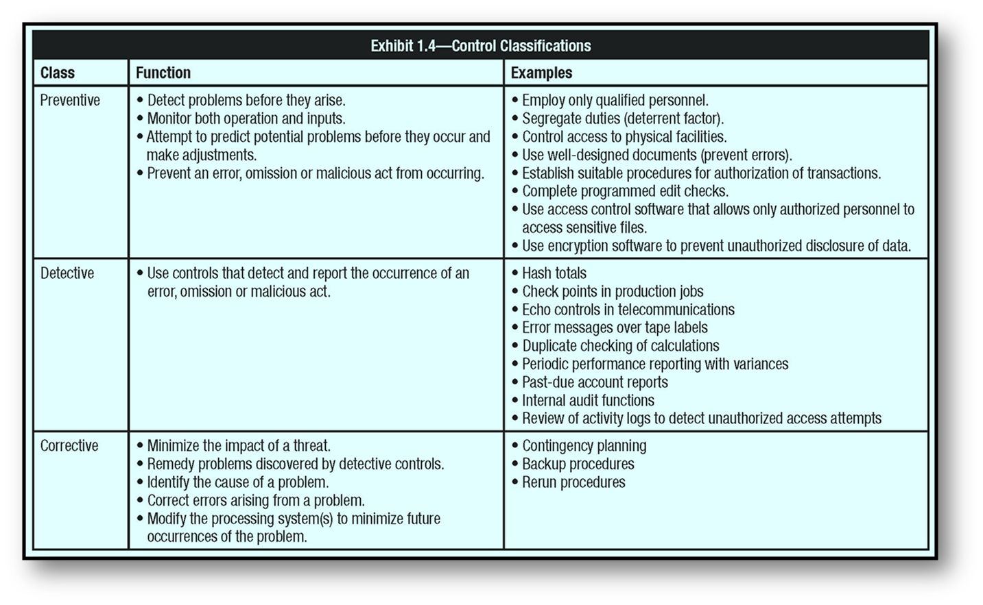
1.4 Internal Controls (continued)
Notes:
Exhibit 1.4 – Control Classifications from the 2012 CISA Review Manual.
Review Manual Reference Pages:
p. 49

Slide 42
1.4.4 COBIT
COBIT 5 provides a comprehensive framework that assist enterprises in achieving their objectives for the governance and management of enterprise IT.
It help enterprise create optimal value from IT by maintaining a balance between realizing benefits and optimizing risk level and resource use .
COBIT 5 based on 5 principles and 7 enablers
Stakeholders Needs, Covering Enterprise End to End, Apply single integrated framework, Enabling holistic approach , Separating Governance and Management
Notes:
Instructor Directions:
A CISA candidate will not be asked to identify specifically the CobiT assurance process, the CobiT domains or the set of IT processes defined in each. However, candidates should know what frameworks are, what they do and why they are used by enterprises. Knowledge of the existence, structure and key principles of major standards and frameworks related to IT governance, assurance and security will also be advantageous. CobiT can be used as a supplemental study material in understanding IT processes, control objectives and principles as detailed in this review material. Please refer to Appendix A for references between the CISA certification domains and the CobiT framework.
Review Manual Reference Pages:
pgs. 49 - 50

Slide 43
1.4.4 COBIT
COBIT 5 - framework defines seven categories of enablers:
Principles, Policies and Frameworks
Processes
Organizational Structures
Culture, Ethics and Behavior
Information
Services, Infrastructure and Applications
People, Skills and Competencies
Notes:
Instructor Directions:
A CISA candidate will not be asked to identify specifically the CobiT assurance process, the CobiT domains or the set of IT processes defined in each. However, candidates should know what frameworks are, what they do and why they are used by enterprises. Knowledge of the existence, structure and key principles of major standards and frameworks related to IT governance, assurance and security will also be advantageous. CobiT can be used as a supplemental study material in understanding IT processes, control objectives and principles as detailed in this review material. Please refer to Appendix A for references between the CISA certification domains and the CobiT framework.
Review Manual Reference Pages:
pgs. 49 - 50

Slide 44
1.4.5 General Controls
Controls include policies, procedures and practices established by management to provide reasonable assurance that specific objectives will be achieved.
Internal accounting controls directed at accounting operations
  Operational controls concerned with the day-to-day operations
Administrative controls that concern operational efficiency in a functional area and adherence to management policies
Organizational security policies and procedures to ensure proper usage of assets
Physical and logical security policies for all facilities, data center and IT resources
Procedures and practices to ensure adequate safeguards over access to and use of assets and facilities
Notes:
Content to Emphasize:
Controls include policies, procedures and practices (tasks and activities) that are established by management to provide reasonable assurance that specific objectives will be achieved.
Review Manual Reference Pages:
p. 50

Slide 45
1.4.6 IS Controls
Each general controls can be translated into IS – specific controls.
IS Controls procedure includes :
Strategy and direction
General organization and management of IT
Access to IT resources, including data and programs
Systems development methodologies and change control
Operations procedures
Systems programming and technical support functions
Notes:
Instructor Directions:
The IS controls listed in this section should be considered by the CISA candidate within the related job practice area, i.e., Protection of Information Assets.
Content to Emphasize:
Each general control procedure can be translated into an IS-specific control procedure. A well-designed information system should have controls built in for all its sensitive or critical functions. For example, the general procedure to ensure adequate safeguards over access to assets and facilities can be translated into an IS-related set of control procedures, covering access safeguards over computer programs, data and computer equipment. The IS auditor should understand the basic control objectives that exist for all functions.
Review Manual Reference Pages:
p. 50

Slide 46
1.4.6 IS Controls (continued)
IS Controls procedure includes :
Quality assurance procedures
Physical access controls
Business continuity/disaster recovery planning
Networks and communications
Database administration
Protection and detective mechanisms against internal and external attacks
Notes:
Instructor Directions:
The IS controls listed in this section should be considered by the CISA candidate within the related job practice area, i.e., Protection of Information Assets.
Review Manual Reference Pages:
p. 50

Slide 47
1.5 Performing an IS Audit
Definition of auditing
Systematic process by which a competent, independent person objectively obtains and evaluates evidence regarding assertions about an economic entity or event for the purpose of forming an opinion about and reporting on the degree to which the assertion conforms to an identified set of standards.
Definition of IS auditing
Any audit that encompasses review and evaluation (wholly or partly) of automated information processing systems, related non-automated processes and the interfaces between them.
Notes:
Instructor Directions:
A discussion on auditing should include audit scope, audit objectives, criteria, audit procedures, evidence, conclusions and opinions, and reporting. Some of these need to be engaged among the CISA candidates at this point.
Review Manual Reference Pages:
p. 50 - 51

Slide 48
1.5 Performing an IS Audit
Audit management must ensure the availability of adequate audit resources and a schedule for performing the audits and, in the case of internal IS audit, for follow-up reviews on the status of corrective actions taken by management.
The process of auditing includes defining audit scope, formulating audit objectives, identifying audit criteria, performing audit procedures, reviewing and evaluating evidence, forming audit conclusions and opinions, and reporting to management after discussion with key process owners
Notes:
Instructor Directions:
A discussion on auditing should include audit scope, audit objectives, criteria, audit procedures, evidence, conclusions and opinions, and reporting. Some of these need to be engaged among the CISA candidates at this point.
Review Manual Reference Pages:
p. 50 - 51

Slide 49
1.5.1 Audit Objectives
Audit Objectives –Audit objectives refer to the specific goals that must be accomplished by the audit.
Audit objectives include assuring compliance with legal and regulatory requirements as well as the confidentiality, integrity, reliability and availability of information and IT resources
Audit objective for IS audit to ensure that editing features are in place to detect errors in the coding of transactions that may impact the account-posting activities.
Notes:
Instructor Directions:
A discussion on auditing should include audit scope, audit objectives, criteria, audit procedures, evidence, conclusions and opinions, and reporting. Some of these need to be engaged among the CISA candidates at this point.
Review Manual Reference Pages:
p. 50 - 51

Slide 50
1.5.2 Classification of Audits
Types of Audit
Compliance Audit (PCI, FISMA, HIPPA)
Financial audits
Operational audits (Application control & logical security systems)
Integrated audits (Combination of Financial & Operational audit)
Administrative audits (Checking efficiency of operational productivity )
IS audits (Safeguard assets, maintain data & system integrity availability,
Specialized audits(SSAE )
Forensic audits(discovering, disclosing and following up on fraud and crimes)
Notes:
Instructor Directions:
Discuss the classifications and give examples of each kind of audit.
Content to Emphasize:
• Financial audits – relates to financial information integrity and reliability.
• Operational audits—examples: IS audits of application controls or logical security systems
• Integrated audits—combines financial and operational audit steps.
• Administrative audits—oriented to assess issues related to the efficiency of operational productivity within an organization.
• IS audits
• Specialized audits—examine areas such as services performed by third parties.
• Forensic audits—auditing specialized in discovering, disclosing and following up on frauds and crimes. The primary purpose of such a review is the development of evidence for review by law enforcement and judicial authorities.
Review Manual Reference Pages:
pgs. 51

Slide 51
1.5.3 Audit Methodology
A set of documented audit procedures designed to achieve planned audit objectives
Composed of:
  Statement of scope
  Audit objectives
  Audit programs
Set up and approved by the audit management to achieve consistency in the audit approach.
Communicated to all audit staff
Notes:
Review Manual Reference Pages:
pgs. 52-53

Slide 52
1.5.3 Audit Methodology (continued)
Audit Phase | Description
Audit Subject | Identify the area to be audited.
Audit Objective | Identify the purpose of the audit
Audit Scope | Identify the specific systems, function or unit of the organization to be included in the review.
Pre-Audit Planning | Identify technical skills and resources needed. Identify the sources of information for test or review such as functional flow charts, policies, standards, procedures and prior audit work papers. Identify locations or facilities to be audited. Develop a communication plan at the beginning of each engagement that describes who to communicate to, when, how often and for what purpose
Notes:
Exhibit 1.5 – Audit Phases from the 2012 CISA Review Manual
Review Manual Reference Pages:
p. 53

Slide 53
1.5.3 Audit Methodology (continued)
Audit Phase | Description
Audit procedures and steps for data gathering | Identify and select the audit approach to verify and test the controls. Identify a list of individuals to interview. Identify and obtain departmental policies, standards and guidelines for review. Develop audit tools and methodology to test and verify control.
Procedures for evaluating the test or review results | Identify methods to perform the evaluation. Identify criteria for evaluating the test Identify means and resources to confirm the evaluation was accurate
Procedures for communication with management | Determine frequency of communication. Prepare documentation for final report.
Audit report preparation | Disclose follow-up review procedures. Disclose procedures to evaluate operational efficiency and effectiveness. Disclose procedures to test controls. Review and evaluate the soundness of documents, policies and procedures
Notes:
Exhibit 1.5 – Audit Phases from the 2012 CISA Review Manual
Review Manual Reference Pages:
p. 53

Slide 54
1.5.3 Audit Methodology (continued)
What is documented in work papers (WPs)?
Audit plans
Audit programs
Audit activities
Audit tests
Audit findings and incidents
Notes:
Review Manual Reference Pages:
pgs. 52-53

Slide 55
1.5.4 Risk-based Auditing
Risk Based Auditing
A risk-based audit approach is usually adapted to develop and improve the continuous audit process.
This approach is used to assess risk and to assist an IS auditor in making the decision to perform either compliance testing or substantive testing.
Effective risk-based auditing is driven by two processes:
1. The risk assessment that drives the audit schedule
2. The risk assessment that minimizes the audit risk during the execution of an audit
Notes:
Instructor Directions:
Discuss Risk-based auditing using Exhibit 1.6 from the 2012 CISA Review Manual.
Content to Emphasize:
the risk-based audit approach efficiently assists the auditor in determining the nature and extent of testing
Review Manual Reference Pages:
p. 54

Slide 56
1.5.4 Risk-based Auditing
Risk Based Auditing
The Risk Based Audit Approach is designed and implemented by the auditor to focus the nature, timing and extent of the audit procedures on those areas which have high potential of material mis-statement.
The auditor should focus on those areas where there is high risk of material mis-statements as compared to those where there is low possibility of risk.
Notes:
Instructor Directions:
Discuss Risk-based auditing using Exhibit 1.6 from the 2012 CISA Review Manual.
Content to Emphasize:
the risk-based audit approach efficiently assists the auditor in determining the nature and extent of testing
Review Manual Reference Pages:
p. 54

Slide 57
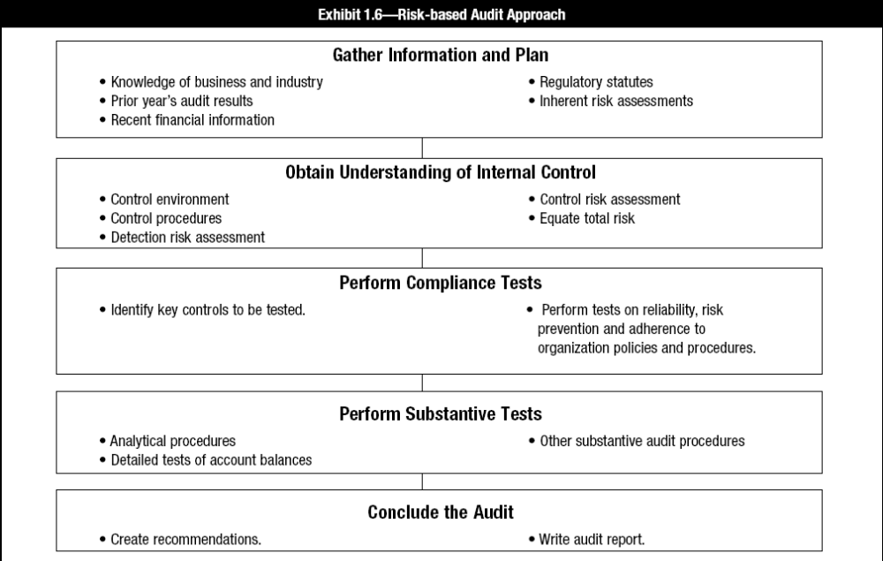
1.5.4 Risk-based Auditing
Notes:
Instructor Directions:
Discuss Risk-based auditing using Exhibit 1.6 from the 2012 CISA Review Manual.
Content to Emphasize:
the risk-based audit approach efficiently assists the auditor in determining the nature and extent of testing
Review Manual Reference Pages:
p. 54

Slide 58
1.5.5 Audit Risk and Materiality
Audit risk can be defined as the risk that information may contain a material error that may go undetected during the course of the audit.
Factors which may influence Audit risk
Inherent risk
Control risk
Detection risk
Overall audit risk
Notes:
Instructor Directions:
Discuss the risk categories and provide examples of each.
Content to Emphasize:
Audit risk should not be confused with statistical sampling risk, which is the risk that incorrect assumptions are made about the characteristics of a population from which a sample is selected.
Review Manual Reference Pages:
pgs. 53 - 54

Slide 59
1.5.6 Risk Assessment and Treatment
Assessing security risks
Risk assessments should identify, quantify and prioritize risks against criteria for risk acceptance and objectives relevant to the organization
Should be performed periodically to address changes in the environment, security requirements and when significant changes occur
The scope of a risk assessment can be either the entire organization, parts of the organization, an individual information system, specific system components or services
Notes:
Review Manual Reference Pages:
pgs. 55

Slide 60
1.5.6 Risk Assessment and Treatment (continued)
Treating Security Risks
Each risk identified in a risk assessment needs to be treated
Controls should be selected to ensure that risks are reduced to an acceptable level
Possible Risk Reponses options
Risk Mitigation, Risk Acceptance , Risk avoidance, Risk Transfer or sharing
Notes:
Review Manual Reference Pages:
pgs. 55

Slide 61
1.5.7 Audit Programs
An audit program is a step by step set of audit procedure and instructions that should be performed to complete an audit.
Audit programs are based on the scope and objective of the particular assignment
IS auditor’s perspectives for evaluating IT systems are :
  Security (confidentiality, integrity and availability)
  Quality (effectiveness, efficiency)
  Fiduciary (compliance, reliability)
  Service and capacity
Notes:
Review Manual Reference Pages:
p. 51 - 52

Slide 62
1.5.8 Audit Programs (continued)
Audit procedures in the performance of an audit usually include
Understanding of the audit area/subject
Risk assessment and general audit plan
Detailed audit planning( work planned across anticipated timeline)
Preliminary review of audit area/subject
Evaluating audit area/subject
Verifying and evaluating controls
Compliance testing (test of implementation of controls)
Substantive testing (Confirming accuracy if information)
Reporting (communicating results)
Follow-up
Notes:
Instructor Directions:
Describe and discuss each audit procedure and its sequence with the class
Review Manual Reference Pages:
p. 52

Slide 63
1.5.8 Audit Programs (continued)
Procedures for Testing and Evaluating IS Controls
Use of generalized audit software to survey the contents of data files(systems logs)
Use of specialized software to assess the contents of operating system parameter files (Detect deficiencies in system parameter setting)
Flow-charting techniques for documenting automated applications and business process
Use of audit logs or reports available in operation systems
Documentation review
Observation
Walkthrough
Notes:
Content to Emphasize:
The IS auditor should have a sufficient understanding of these procedures to allow for the planning of appropriate audit tests.
Review Manual Reference Pages:
p. 52

Slide 64
1.5.9 Fraud Detection
Use of information technology for business has immensely benefited enterprises in terms of significantly increased quality of delivery of information. However, the widespread use of information technology and the Internet leads to risk that enables the perpetration of errors and fraud.
Management is responsible for implementing and maintaining a framework and design of IT controls to meet control objectives.
A well design internal controls system provides good opportunity for deterrence and timely detection of fraud.
Notes:
Review Manual Reference Pages:
p. 53

Slide 65
1.5.9 Fraud Detection
Benefits of a well-designed internal control system:
  Deterring fraud at the first instance
  Detecting fraud in a timely manner
  Protecting fraud to happen
Auditor should be aware of potential legal requirements concerning the implementation of specific fraud detection procedure and reporting to appropriate authorities
Notes:
Review Manual Reference Pages:
p. 53

Slide 66
1.5.10 Compliance vs. Substantive Testing
Compliance test
  Determines whether controls are in compliance with management policies and procedures
  Example : A data center tests its infrastructure services for compliance to information security regulations
Substantive test
  Substantive testing gathers evidences to evaluate the integrity of individual transactions, data or other information's
  Substantive testing is an audit procedure that examines the financial statements and supporting documentation to see if they contain errors .
Notes:
Instructor Directions:
The IS auditor should be knowledgeable on when to perform compliance tests or substantive tests. See Exhibit 1.5 from the 2012 CISA Review Manual on the following slide.
Review Manual Reference Pages:
p. 56

Slide 67
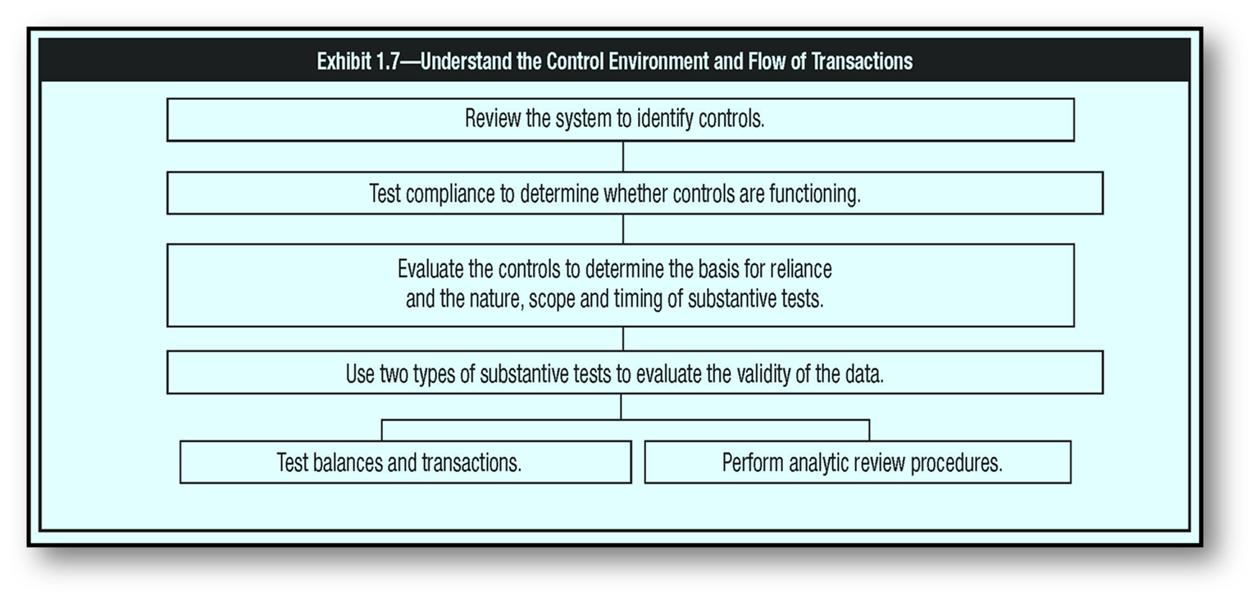
1.5.10 Compliance vs. Substantive Testing (continued)
Notes:
Instructor Directions:
The IS auditor should be knowledgeable on when to perform compliance tests or substantive tests.
Exhibit 1.7 – Understand the Control Environment and Flow of Transactions from the 2012 CISA Review Manual.
Review Manual Reference Pages:
p. 57

Slide 68
1.5.11 Evidence
Records , Statement of facts or other information, which are relevant to audit criteria and verifiable :
Independence of the provider of the evidence
  Qualification of the individual providing the information or evidence
  Objectivity of the evidence
  Timing of the evidence
Notes:
Instructor Directions:
Knowledge of the evidence life cycle is difficult to test in the CISA exam because of the various laws and regulations governing the collection, protection and chain of custody of evidence. This topic, though relevant for the IS auditor, is not currently tested in the CISA exam.
Review Manual Reference Pages:
pgs. 56 - 58

Slide 69
1.5.11 Evidence (continued)
Techniques for gathering evidence:
  Review IS organization structures
  Review IS policies and procedures
  Review IS standards
  Review IS documentation
  Interview appropriate personnel
  Observe processes and employee performance
  Walkthrough
Notes:
Instructor Directions:
A CISA candidate, given an audit scenario, should be able to determine which type of evidence gathering technique would be best.
Review Manual Reference Pages:
pgs. 56 - 58

Slide 70
1.5.12 Interviewing and Observing Personnel in Performance of Their Duties
  Observing the personnel In the performance of their duties assist auditor in identifying
  Actual functions ( it ensures that right person is doing the right task)
  Actual processes/procedures (It ensures compliance or observations)
  Security awareness (To ensure if employees understand the security controls to protect company asset and data)
  Reporting relationships (ensure Segregation of duties are practiced )
Notes:
Review Manual Reference Pages:
p. 58 - 59

Slide 71
1.5.13 Sampling
Sample - The subset of population members used to perform testing is called a sample.
Sampling is used to infer characteristics about a population based on the characteristics of a sample.
General approaches for audit sampling:
Statistical sampling- Using mathematical laws of probability to create the sample size
Non-statistical sampling – Auditor Using own judgement or experience to create the sample.
Notes:
Instructor Directions:
Increasing regulation of organizations has led to a major focus on the IS auditor’s ability to verify the adequacy of internal controls though the use of sampling techniques. This has become necessary since many controls are transactional in nature, which can make it difficult to test the entire population. Although a candidate is not expected to become a sampling expert, it is important for the candidate to have a foundational understanding of the general principles of sampling and how to design a sample that can be relied upon.
Review Manual Reference Pages:
pgs. 59-60

Slide 72
1.5.13 Sampling (continued)
Primary method of sampling :
Attribute sampling - Applied in compliance testing situations, deals with the presence or absence of the attribute and provides conclusions that are expressed in rates of incidence.
Attribute sampling – It applied on compliance testing
Variable sampling - Applied in substantive testing situations, deals with population characteristics that vary, such as monetary values and weights or any other measurement and provides conclusions related to deviations from the norm.
Variable Sampling – It applied on Substantive testing
Example : Review of organization balance sheet
Notes:
Review Manual Reference Pages:
pgs. 59-60

Slide 73
1.5.13 Sampling (continued)
Types of Attribute sampling :
Attribute sampling- It involves selecting a small number of transactions and making assumptions about how their characteristics represent the full population of which the selected items are a part
  Stop-or-go sampling – This model help prevents excessive sampling of an attribute by allowing an audit test to be stopped at the earliest possible moment. It is mostly used when auditor believes that relatively few errors will be found in populations.
  Discovery sampling – It is mostly used when the objective of audit is to discover fraud.
Notes:
Review Manual Reference Pages:
pgs. 59-60

Slide 74
1.5.13 Sampling (continued)
Types of Variable sampling :
  Stratified mean per unit – It a statistical model in which population is divided into groups and samples are drawn from the various groups
  Unstratified mean per unit – A statistical model in which sample mean (Average) is calculated and projected as an estimated total.
  Difference estimation – Statistical model used to estimate the total difference between audited values and unaudited values based on differences obtained from sample observations.
Notes:
Review Manual Reference Pages:
pgs. 59-60

Slide 75
1.5.13 Sampling (continued)
Statistical sampling terms:
Confident coefficient – A percentage expression of the probability that the characteristics of sample are true representation of the population.
Stronger the internal control lower the confident coefficient
Level of risk – Equal to one minus the confidence coefficient { if cc is 95% the level of risk is (100-95= 5%)}
Precision- It represent that acceptable range difference between sample and actual population.
(Attribute = Always in % & Variable – Always in No.)
Expected error rate – An estimate stated as a percent of the error that may exist . The greater the ERR greater the sample size
Notes:
Instructor Directions:
The IS auditor should be familiar with the different types of sampling techniques and when it is appropriate to use each of them.
Review Manual Reference Pages:
pgs. 59-60

Slide 76
1.5.13 Sampling (continued)
Statistical sampling terms (continued):
Sample mean
Sample standard deviation- A quantity expressing by how much the members of a group differ from the mean value for the group..
Tolerable error rate- Maximum misstatement or number of error that can exist without an account being materially misstated
Population standard deviation- Mathematical concept that measure the relationship to normal distribution. The greater the standard deviations greater the sample size.
Notes:
Instructor Directions:
The IS auditor should be familiar with the different types of sampling techniques and when it is appropriate to use each of them.
Review Manual Reference Pages:
pgs. 59-60

Slide 77
1.5.13 Sampling (continued)
Key steps in choosing a sample:
Determine the objectives of the test
Define the population to be sampled
Determine the sampling method, such as attribute versus variable sampling
Calculate the sample size
Select the sample
Evaluating the sample from an audit perspective
Notes:
Content to Emphasize:
It is important to know that tools exist to analyze all of the data, not just those available through computer-assisted audit techniques.
Review Manual Reference Pages:
pgs. 59-60

Slide 78
1.5.14 Using the Services of Other Auditors and Experts
Considerations when using services of other auditors and experts:
Restrictions on outsourcing of audit/security services provided by laws and regulations
Audit charter or contractual stipulations
Impact on overall and specific IS audit objectives
Impact on IS audit risk and professional liability
Independence and objectivity of other auditors and experts
Notes:
Content to Emphasize:
The IS auditor should be familiar with ISACA’s Auditing Standard on “Performance of Audit Work” (S6) and the IS Auditing Guideline “Using the Work of Other Auditors” (G1) focusing on the Rights of Access to the Work of Other Auditors or Experts.
Review Manual Reference Pages:
p. 60 - 61

Slide 79
1.5.14 Using the Services of
Other Auditors and Experts (cont’d)
Considerations when using services of other auditors and experts:
Professional competence, qualifications and experience
Scope of work proposed to be outsourced and approach
Supervisory and audit management controls
Method and modalities of communication of results of audit work
Compliance with legal and regulatory stipulations
Compliance with applicable professional standards
Notes:
Instructor Directions:
IS auditor should be familiar with ISACA’s Auditing Standard on “Performance of Audit Work” (S6) and the IS Auditing Guideline “Using the Work of Other Auditors” (G1) focusing on the Rights of Access to the Work of Other Auditors or Experts.
Content to Emphasize:
It is the responsibility of the IS auditor or entity employing the services of external service providers to:
• Clearly communicate the audit objectives, scope and methodology through a formal engagement letter.
• Put in place a monitoring process for regular review of the work of the external service provider with regard to planning, supervision, review and documentation.
• Assess the usefulness and appropriateness of reports of such external providers and assess the impact of significant findings on the overall audit objectives.
Review Manual Reference Pages:
p. 60 - 61

Slide 80
1.5.15 Computer-assisted Audit Techniques
CAAT is a software tool which can collect and analyze the records from various systems. It enable IS auditors to gather information independently
CAATs include many tool and techniques :
  Generalized audit software (GAS)
  Utility software
  Debugging and scanning software
  Test data
  Application software tracing and mapping
  Expert systems.
Notes:
Instructor Directions:
The IS auditor should have a thorough understanding of CAATs and know where and when to apply them. Please refer to G3: ISACA Guideline on Computer Assisted Audit Techniques.
Review Manual Reference Pages:
pgs. 61-62

Slide 81
1.5.15 Computer-assisted Audit Techniques (continued)
Features of generalized audit software (GAS):
  Mathematical computations
  Duplication checking
  Statistical analysis
  Sequence checking
  Recomputations
Functions supported by GAS:
  File access
  File reorganization
  Data selection
  Statistical functions
  Arithmetical functions
Notes:
Instructor Directions:
The IS auditor should have a thorough understanding of CAATs and know where and when to apply them. Please refer to G3: ISACA Guideline on Computer Assisted Audit Techniques.
Review Manual Reference Pages:
pgs. 61-62

Slide 82
1.5.15 Computer-assisted Audit Techniques (continued)
Items to consider before utilizing CAATs:
Ease of use for existing and future audit staff
Training requirements
Complexity of coding and maintenance
Flexibility of uses
Installation requirements
Processing efficiencies
Confidentiality of data being processed
Notes:
Instructor Directions:
The IS auditor should have a thorough understanding of CAATs and know where and when to apply them. Please refer to G3: ISACA Guideline on Computer Assisted Audit Techniques.
Review Manual Reference Pages:
pgs. 61-62

Slide 83
1.5.15 Computer-assisted Audit Techniques (continued)
CAAT as a continuous online audit approach:
It Improves audit efficiency through continuous online auditing techniques
IS auditors must:
develop audit techniques for use with advanced computerized systems
be involved in the creation of advanced systems
make greater use of automated tools that are suitable for their organizations automated environment
Notes:
Review Manual Reference Pages:
pgs. 61-62

Slide 84
1.5.16 Evaluation of Audit Strengths and Weaknesses
The auditor will review evidence gathered during audit to determine if the operations reviewed are well controlled and effective
Assess the strength and weakness of controls evidence
The auditor should be aware of compensating controls in areas where controls have been identified as week
IS auditor should always review for compensating controls prior to reporting a control weakness
Notes:
Content to Emphasize:
The IS auditor will review evidence gathered during the audit to determine if the operations reviewed are well controlled and effective. This is also an area that requires the IS auditor’s judgment and experience. The IS auditor should assess the strengths and weaknesses of the controls evaluated and then determine if they are effective in meeting the control objectives established as part of the audit planning process.
Review Manual Reference Pages:
pgs. 62

Slide 85
1.5.16 Evaluation of Audit Strengths and Weaknesses (cont’d)
Judging materiality of findings
Auditor must use judgement when deciding which findings to present to various levels of management.
Materiality is a key issue when deciding which finding to bring forward in audit report.
Assessment requires judgment of the potential effect of the finding if corrective action is not taken
Notes:
Content to Emphasize:
The IS auditor must use judgment when deciding which findings to present to various levels of management. For example, the IS auditor may find that the transmittal form for delivering tapes to the offsite storage location is not properly initialed or authorization evidenced by management as required by procedures. If the IS auditor finds that management otherwise pays attention to this process and that there have been no problems in this area, the IS auditor may decide that the failure to initial transmittal documents is not material enough to bring to the attention of upper management. The IS auditor might decide to discuss this only with local operations management. However, there may be other control problems that will cause the IS auditor to conclude that this is a material error, because it may lead to a larger control problem in other areas. The IS auditor should always judge which findings are material to various levels of management and should report them accordingly.
Review Manual Reference Pages:
pgs. 62

Slide 86
1.5.17 Communicating Audit Results
Exit interview
  Facts presented in the report are Correct
  Realistic & Cost Effective recommendations
  Implementation dates for agreed recommendations
Presentation techniques
  Executive summary
  Visual presentation
Notes:
Content to Emphasize:
IS auditors should be aware that, ultimately, they are responsible to senior management and the audit committee of the board of directors. IS auditors should feel free to communicate issues or concerns to such management. An attempt to deny access by levels lower than senior management would limit the independence of the audit function.
Review Manual Reference Pages:
pgs. 62-64

Slide 87
1.6.1Audit report structure and contents
)
Audit report structure and contents
An introduction to the report
Audit findings presented in separate sections
The IS auditor’s overall conclusion and opinion
Detailed audit findings and recommendations
A variety of findings, some of which may be quite material while others are minor in nature
Notes:
Review Manual Reference Pages:
pgs. 62-64

Slide 88
1.6.1 Management Implementation of Recommendations
Auditing is an ongoing process – Audit & Auditor is not successful if reports issued to management however follow-up were not done to ensure whether management has taken an appropriate corrective action.
Auditors should have a follow up program to determine if agreed on corrective action have been implemented.
Timing of follow-up will depend on criticality of the observations and follow up results should be communicated to management.
Notes:
Content to Emphasize:
IS auditors should realize that auditing is an ongoing process. The IS auditor is not effective if audits are performed and reports issued, but no follow-up is conducted to determine if management has taken appropriate corrective actions. IS auditors should have a follow-up program to determine if agreed-to corrective actions have been implemented. Although IS auditors who work for external audit firms may not necessarily follow this process, they may achieve these tasks if agreed to by the audited entity.
Review Manual Reference Pages:
pgs. 64

Slide 89
1.6.12 Audit Documentation
Audit documentation includes:
Planning and preparation of the audit scope and objectives
Description on the scoped audit area
Audit program
Audit steps performed and evidence gathered
Other experts used
Audit findings, conclusions and recommendations
Notes:
Instructor Directions:
The CISA candidate should be familiar with the detailed content of the IS Audit Guideline “Audit Documentation” (G8).
Content to Emphasize:
It is also recommended that documentation include:
• A copy of the report issued as a result of the audit work
• Evidence of audit supervisory review
Review Manual Reference Pages:
p. 64

Slide 90
1.6.3 Closing Finding
Audit Closing: Auditing is an ongoing process
IS auditor is not effective if audits are performed and reports issued, but no follow-up is conducted to determine whether management has taken appropriate corrective actions
IS auditors should have a follow-up program to determine if agreed-on corrective actions have been implemented.
The timing of the follow-up will depend on the criticality of the findings and would be subject to the IS auditor's judgment
Notes:
Instructor Directions:
The CISA candidate should be familiar with the detailed content of the IS Audit Guideline “Audit Documentation” (G8).
Content to Emphasize:
It is also recommended that documentation include:
• A copy of the report issued as a result of the audit work
• Evidence of audit supervisory review
Review Manual Reference Pages:
p. 64

Slide 91
1.7 Control Self-Assessment
Control self-assessment (CSA) is an assessment of controls made by the staff and management of the unit or units involved.
CSA- are a mechanism to drive accountability across the organization and seek positive assurance from line management on internal controls.
It is a management technique that assures stakeholders, customers and other parties that the internal control system of the organization is reliable.
It also ensures that employees are aware of the risk to the business and they conduct periodic, proactive reviews of controls
Notes:
Instructor Directions:
Discuss CSA as a management technique. Ask participants how it might be implemented and what methodology would be used. See diagram on next slide.
Review Manual Reference Pages:
pgs. 64 - 65

Slide 92
1.7 Control Self-Assessment
Benefit of CSA
Embeds controls awareness culture in the organization
Drives compliance with laid down policies and procedures
Instills a culture of self-accountability across the organization
Prioritizes independent testing efforts in high risk areas
Enables benchmarking business units against each other and against leading industry practices
Enables reduction of manual effort and costs.
SIAI – Self Identified Audit Issues
Notes:
Instructor Directions:
Discuss CSA as a management technique. Ask participants how it might be implemented and what methodology would be used. See diagram on next slide.
Review Manual Reference Pages:
pgs. 64 - 65

Slide 93
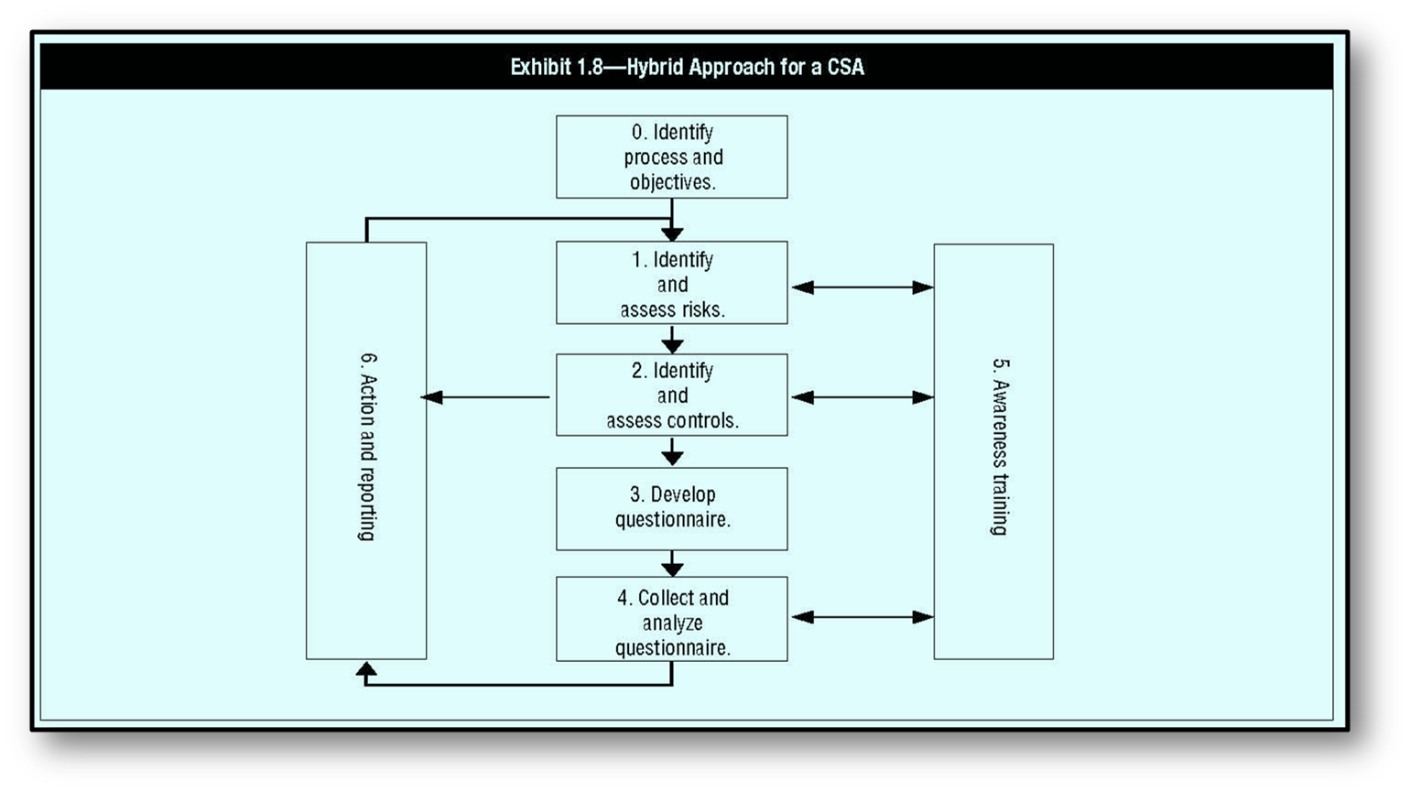
1.7 Control Self-Assessment (continued)
Notes:
Instructor Directions:
Exhibit 1.8 – Hybrid Approach for a CSA from the 2012 CISA Review Manual.
Review Manual Reference Pages:
p. 65

Slide 94
1.7.1 Objectives of CSA
Leverage the internal audit function by shifting some control monitoring responsibilities to functional areas
Enhancement of audit responsibilities, not a replacement
Educate management about control design and monitoring
Empowerment of workers to assess the control environment
Notes:
Content to Emphasize:
When employing a CSA program, measures of success for each phase (planning, implementation and monitoring) should be developed to determine the value derived from CSA and its future use. One critical success factor (CSF) is to conduct a meeting with the business unit representatives, including appropriate and relevant staff and management, to identify the business unit’s primary objective, which is to determine the reliability of the internal control system. In addition, actions that increase the likelihood of achieving the primary objective should be identified.
Review Manual Reference Pages:
pgs. 66

Slide 95
1.7.2 Benefits of CSA
Early detection of risks
More effective and improved internal controls
Increased employee awareness of organizational objectives
Highly motivated employees
Increased communication between operational and top management
Improved audit rating process
Reduction in control cost
Assurance provided to stakeholders and customers
Notes:
Review Manual Reference Pages:
p. 66

Slide 96
1.7.3 Disadvantages of CSA
Could be mistaken as an audit function replacement
May be regarded as an additional workload
Failure to act on improvement suggestions could damage employee morale
Lack of motivation may limit effectiveness in the detection of weak controls
Notes:
Review Manual Reference Pages:
p. 66

Slide 97
1.7.4 Auditor Role in CSA
IS auditors become :
Internal control professionals
Assessment facilitators
Notes:
Content to Emphasize:
The auditor’s role in CSAs should be considered enhanced when audit departments establish a CSA program. When these programs are established, auditors become internal control professionals and assessment facilitators. Their value in this role is evident when management takes responsibility and ownership for internal control systems under their authority through process improvements in their control structures, including an active monitoring component.
Review Manual Reference Pages:
p. 66

Slide 98
1.7.6 Traditional vs.
CSA Approach
Traditional Approach
  Assigns duties/supervises staff
  Policy/rule driven
  Limited employee participation
  Narrow stakeholder focus
  Auditors
CSA Approach
  Empowered/accountable employees
  Continuous improvement/learning curve
  Extensive employee participation and training
  Broad stakeholder focus
  Staff at all levels
Notes:
Review Manual Reference Pages:
p. 66 - 677

Slide 99
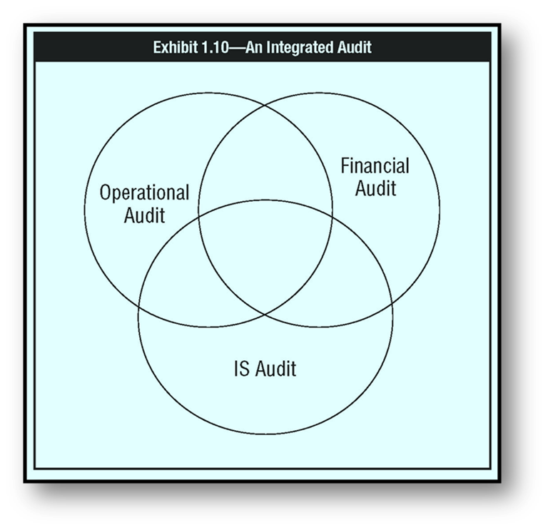
1.8.1 Integrated Auditing
(continued)
Process involves:
Identification of risks faced by organization and of relevant key controls
Review and understanding of the design of key controls
Testing that key controls are supported by the IT system
Testing that management controls operate effectively
A combined report or opinion on control risks, design and weaknesses
Notes:
Instructor Directions:
This topic on Integrated Auditing, though important, is not specifically tested in the CISA exam.
Content to Emphasize:
The integrated audit demands a focus on business risk and a drive for creative control solutions. It is a team effort of auditors with different skill sets. Using this approach permits a single audit of an entity with one comprehensive report. An additional benefit is that this approach assists in staff development and retention by providing greater variety and the ability to see how all of the elements (functional and IT) mesh together to form the complete picture. See exhibit 1.8 for an integrated auditing approach.
Review Manual Reference Pages:
p. 67

Slide 100
1.8.2 Continuous Auditing (continued)
Continuous auditing vs. continuous monitoring
Continuous monitoring
Provided by IS management tools and typically based on automated procedures to meet fiduciary responsibilities
Continuous auditing
It is an automatic method used to perform auditing activities, such as control and risk assessments, on a more frequent basis
A methodology that enable independent auditor to provide written assurance on subject matter.
It aims to provide a more secure platform to avoid fraud and real time process aimed at ensuring a high level of financial control
Notes:
Instructor Directions:
This section on Continuous Auditing reflects the knowledge statement of continuous audit techniques (KS1.10); however, this is not specifically tested in the CISA exam.
Review Manual Reference Pages:
pgs. 67 - 69

Slide 101
1.8.2 Continuous Auditing (continued)
Application of continuous auditing due to:
New information technology developments
Increased processing capabilities
Standards
Artificial intelligence tools
Notes:
Instructor Directions:
This section on Continuous Auditing reflects the knowledge statement of continuous audit techniques (KS1.10); however, this is not specifically tested in the CISA exam.
Review Manual Reference Pages:
pgs. 67 - 69

Slide 102
1.8.2 Continuous Auditing (continued)
IT techniques that are used in a continuous auditing environment must work at all data levels :
Transaction logging
Query tools
Statistics and data analysis (CAAT)
Database management systems (DBMS)
Data warehouses, data marts and data mining
Intelligent agents
Embedded audit modules (EAM)
Neural network technology
Standards such as Extensible Business Reporting Language
Notes:
Instructor Directions:
This section on Continuous Auditing reflects the knowledge statement of continuous audit techniques (KS1.10); however, this is not specifically tested in the CISA exam.
Review Manual Reference Pages:
pgs. 67 - 69

Slide 103
1.8.2 Continuous Auditing (continued)
Advantages
  Instant capture of internal control problems
  Reduction of intrinsic audit inefficiencies
Disadvantages
  Difficulty in implementation
  High cost
Notes:
Instructor Directions:
This section on Continuous Auditing reflects the knowledge statement of continuous audit techniques (KS1.10); however, this is not specifically tested in the CISA exam.
Review Manual Reference Pages:
pgs. 67 - 69

Slide 104
THANKS
Notes:
Review Manual Reference Pages:
p. 33

